Slide 1
Lecture 20
Priority Queues Heaps and Sorting Algorithms

Slide 2
Announcements
Thank you
For your patience
Gave us time to figure out equitable solution
Exam “make-ups”
Interview grading
Corrected start-up code on Moodle
March 6-12
Midterm2 - Starter code
Directions for addNode in midterm.cpp

Slide 3
Announcements
Exam details (results,etc.)
The short answer – not good
Exam Prep
Multiple choice
Straight from review question
Work on them, next time
Time
PLEASE be on time

Slide 4
What We’ll Cover
Pruning Search Space
BSTs
Priority Queues (which can use BSTs)
Heaps
Later this week
More on heaps
Recursive sorting algorithms

Slide 5
Pruning Search Space
Ways to limit
What gets searched
NOT changing tree structure
Consider searching for nodes
Whose values fall within a range
x < nodeval < y
Could visit every node

Slide 6
Consider This Tree
Suppose I want to output
All #s such that
1 <= n <= 15
5
3
10
1
4
15
8

Slide 7
void checkNode(Node *n, int low, int high) {
if(n != NULL){
if(n->key >= low and n->key <= high){
cout<<n->key<<endl;
checkNode(n->left, low, high);
checkNode(n->right, low, high);
} else if(n->key < low) {
checkNode(n->right, low, high);
} else if(n->key > high) {
checkNode(n->left, low, high);
}
}
}
What traversal method am I using?

Slide 8
Remember
Recursion
MUST have a terminating condition
if(n != NULL){ … }

Slide 9
Checknode : Break it down
if(n->key >= low and n->key <= high){
cout<<n->key<<endl;
checkNode(n->left, low, high);
checkNode(n->right, low, high);
5
3
10
1
4
15
8

Slide 10
What if low = 10; high = 15
else if(n->key <= low){
checkNode(n->right, low, high);
5
3
10
1
4
15
8

Slide 11
What if low = 10; high = 15
if(n->key >= low and n->key <= high){
5
3
10
1
4
15
8

Slide 12
What if low = 10; high = 15
cout<<n->key<<endl;
checkNode(n->left, low, high);
checkNode(n->right, low, high);
5
3
10
1
4
15
8

Slide 13
What if low = 10; high = 15
else if(n->key <= low){
checkNode(n->right, low, high);
5
3
10
1
4
15
8

Slide 14
OR What if low = 1; high = 4?
} else if(n->key > high) { checkNode(n->left, low, high);
5
3
10
1
4
15
8

Slide 15
Does this version of CheckNode use
void checkNode(Node *n, nt low,
int high){
if(n != NULL) {
if((n->key >= low) && (n->key <= high) { checkNode(n->left, low, high); cout<<n->key<<endl; checkNode(n->right, low, high);
} else if(n->key < low) { checkNode(n->right, low, high)
} else if(n->key > high) { checkNode(n->left, low, high); }
}
In order Traversal
Pre order Traversal
Post order Traversal
HUH?

Slide 16
Priority Queues
A priority queue is a queue where:
• Requests are inserted in the order of arrival
• Request with highest priority
Processed first (deleted from the queue)
• Priority indicated by a number
Lower number = higher priority

Slide 17
Priority Queue
A stack is first in, last out
• A queue is first in, first out
• A priority queue is least-first-out

Slide 18
Priority Queue
least-first-out
OR largest first out ( your choice)
• “Smallest” element is first one removed
Definition of “smallest” is up to programmer
• If multiple “smallest” elements
implementer decide which to remove first
– Remove any random “smallest” element
– OR Remove the first one added

Slide 19
Priority Queue Applications
Any event/job mgmt system
Assign priority to events/jobs
• In Operating Systems
– Scheduling jobs
• In Simulators
– Scheduling next event
smallest event time
• ER

Slide 20
Evaluating Implementations
Based on usage patterns
e.g., an array
If loaded once
but do thousands of searches on it
Searching should be fast: sort array
If array is huge
but rarely searched
Don't want to spend time sorting

Slide 21
Priority Queue: Evaluating Implementations
Queue Applications
Everything added – eventually removed
This includes a priority queues
With a priority queue
“add” and “remove” equally important
Consider timing for “add + remove”

Slide 22
Priority Queue: Array Implementations
• Unsorted array (w/ count of elements)
Adding an element would take O(1) time
why?
Removing an element would take O(n) time
why?
SO Adding and Removing an element takes
O(n) time
i.e., not efficient

Slide 23
Priority Queue: Array Implementations
Sorted array (w/ count of elements)
Adding an element would take O(n) time
why?
Removing an element would take O(1) time
why?
Adding + removing an element
O(n) time
Same inefficiency

Slide 24
Priority Queue: Linked List Implementations
Unsorted linked list
Adding an element - O(1) : why?
Removing an element - O(n) : why?
Sorted linked list
Adding an element - O(n) : Why?
Removing an element would take O(1): Why?
Adding and removing an element - O(n)
Same inefficiency

Slide 25
Priority Queue: Binary Tree Implementation
Binary search tree
(not necessarily balanced)
Insertion
Range from O(log n) - O(n)
Removal
range from O(log n) - O(n)

Slide 26
Priority Queue: Binary Tree Implementation
Balanced binary search tree
Insertion and removal could destroy the balance
Need an algorithm to rebalance the binary tree
Good rebalancing algorithms - O(log n)
but complicated

Slide 27
Without Going into the Algorithm
struct PriorityQueueNode {
void *dataptr;
int priority;
PriorityQueueNode *leftChild;
PriorityQueueNode *rightChild;
PriorityQueueNode *parent;
}

Slide 28
Heaps
Two meanings
Depends on context
In compilers heap refers to a
Large
Unordered
Storage area
Used for new and delete operations

Slide 29
Heap
In data structures
a specialized binary tree
Formally: A binary heap
Partially ordered complete binary tree
Complete Binary Tree
Tree is completely filled
On all levels except possibly the lowest.
Nodes at the last level do not have children.
Nodes are inserted at the last level from left to right.

Slide 30
Complete Binary Tree
What do we know about this tree?
Nodes flow to left
0
3
1
4

Slide 31
What do we know about this tree?
It’s not a binary search tree
It’s a complete tree
It’s a binary search tree
A and B
B and C
0
3
1
4
5

Slide 32
Heap Implementation
Heap property:
Each node has higher priority than child
3
Priority queue: Blue node
has the heap property
Priority queue: Blue node
has the heap property
8
12
Priority queue: Blue node
has the heap property

Slide 33
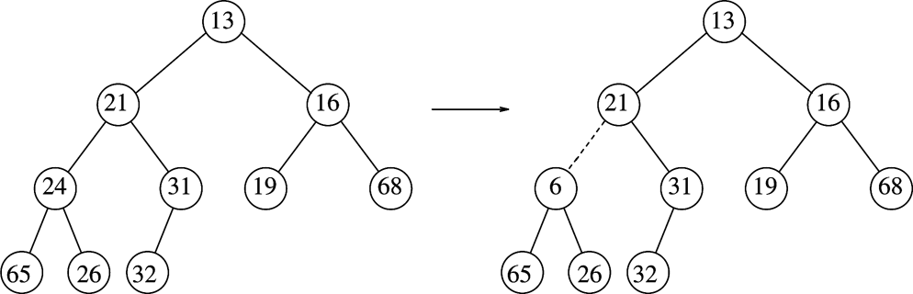
Which tree is a heap
Left tree
Right tree

Slide 34
Types of heaps
What we’ve seen so far
min heap
lowest value at root
Every node has a smaller value
than either of its children
Also could have a max heap

Slide 35
min - heap
3
10
6
13
17
9
7
16
14
21
20
19
21
8
15

Slide 36
Array Implementation of Complete Binary Tree
Storing elements in array in level-order
Parent of v[k] = v[k/2]
Left child of v[k] = v[2*k]
Right child of v[k] = v[2*k + 1]
0 1 2 3 4 5 6 7
One Option: root at index 1
R
l
r
R
R
R
R
R
R
ll
R
l
r
lr
R
ll
lr
rl
R
rl
rr
rr

Slide 37
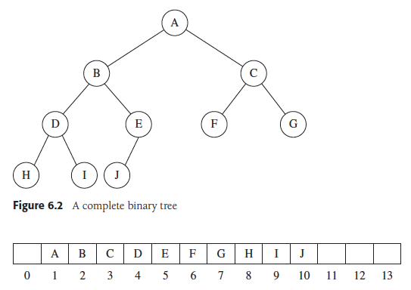
Array implementation of a Complete Binary Tree

Slide 38
Array Representation of a Heap
Left child of node i is 2*i, right child is 2*i + 1
If computation yields
value > lastIndex
=> no such child
Parent of node i = i/2
unless i==0
0 1 2 3 4 5 6 lastIndex = 6
3
12
6
R
R
R
3
R
R
18
R
12
6
14
R
18
14
8
8
R

